Slide 1
TEAM INTELLIGENCE
Weekly Progress Presentation
Emotional Diary
2023.10.13

Slide 2

INDEX
Overview of the service
Feedback and improvements
UI/UX
Plan
02

Slide 3




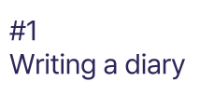
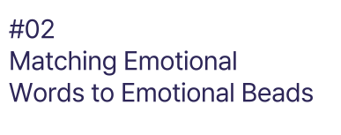
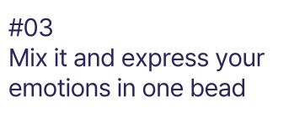

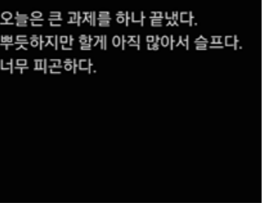
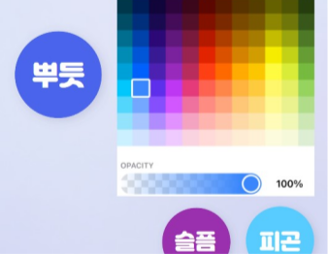



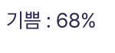
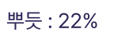
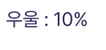
1. Overview of the service
03
Notes:
지난번에 발표했던 우리의 서비스에 대해서 간략하게 설명

Slide 4
2. Feedbacks and Improvements
What is the clear strength of our service?
How can deal with short or fact-based diary?
It can be hard to extract feelings.
04
Notes:
지난번에 발표했던 우리의 서비스에 대해서 간략하게 설명

Slide 5

What is the clear strength of our service?
Extract Feelings Immediately
Easy to achieve diary-writing routine by collecting beautiful beads
Unlike other apps, users can choice multiple emotions easily
Planning to connect users with counselors by using emotional data
05

Slide 6
How can deal with short or fact-based diary?
In this case, users will choose their emotions directly.
If the user doesn’t choice any emotion, we will suggest ‘no-emotion’ with grey bead.
Also, we are considering to just check the degree of good feeling.
Did you feel good today?
Very bad
Bad
So-so
Good
Very good
06

Slide 7
It can be hard to extract feelings.
Yes, Emotions are often ambiguous and difficult to measure accurately.
We aim to address this by providing recommendations to the user
We plan to enhance performance through prompt engineering and are also considering using a limited set of emotions in AI recommendations.
07
Notes:
Now I would respond to the question 'It can be hard to extract feelings’ Yes, Emotions are often ambiguous and difficult to measure accurately. So we aim to address this by providing recommendations to the user. User can edit the initial recommendation. Also, We plan to enhance performance through prompt engineering and are considering using a limited set of emotions in AI recommendations.

Slide 8
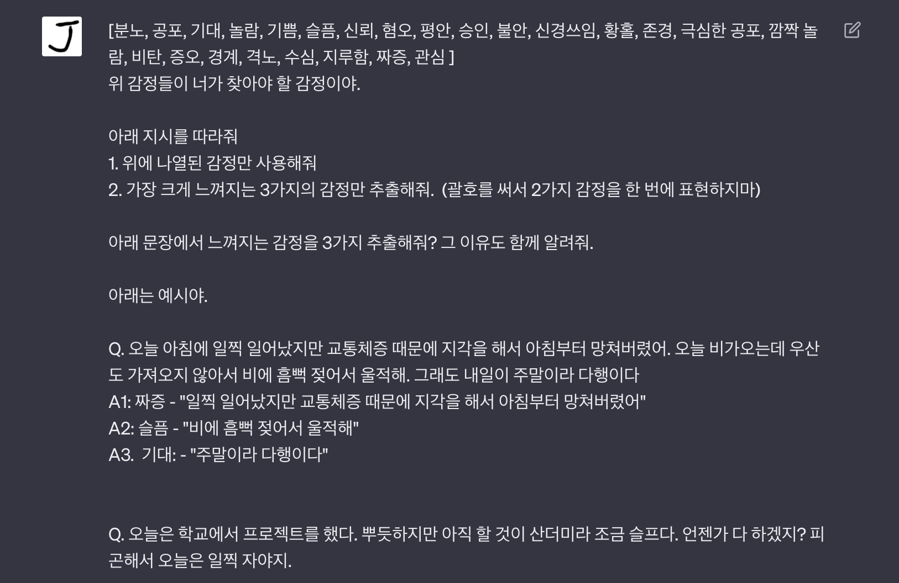
Emotion extraction Test
Prompt
07
Notes:
We tested the emotion extraction performance of the AI model. Based on the Plutchik's Emotion Wheel, we provides predefined emotions and instructs to identify emotional elements in a given sentence and extract the emotion. We also provided an example with one question and its corresponding answer set.

Slide 9
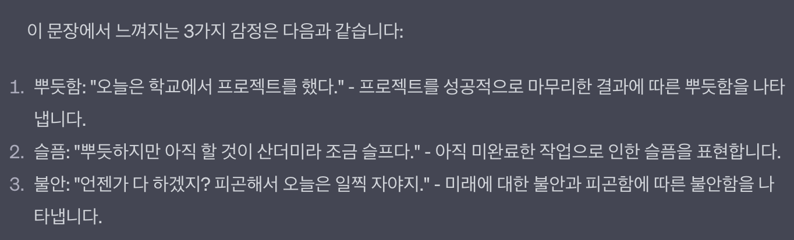


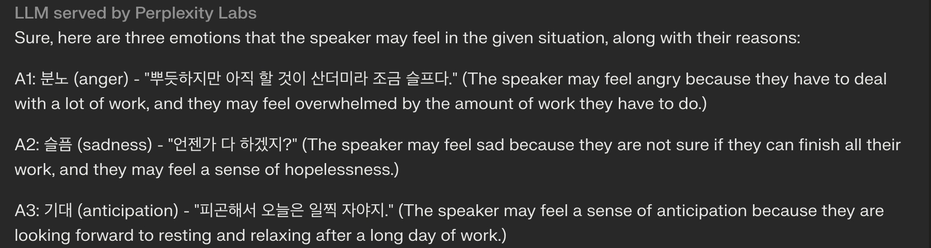
Emotion extraction Test
ChatGPT (GPT-3.5)
Llama-2-70b-chat
07
Notes:
First, we conducted tests using the same prompt with OpenAI's ChatGPT and Meta AI's Llama(라마). Old Korean nlp models, such as KoGPT2, were unable to comprehend the task and provide accurate responses, so we excluded them from the testing model set. The results from the two models showed some differences. In the case of LLama, there was an error in interpreting sadness as anger. Our team will create additional test sets and test various versions of ChatGPT and LLama to select the best model.

Slide 10

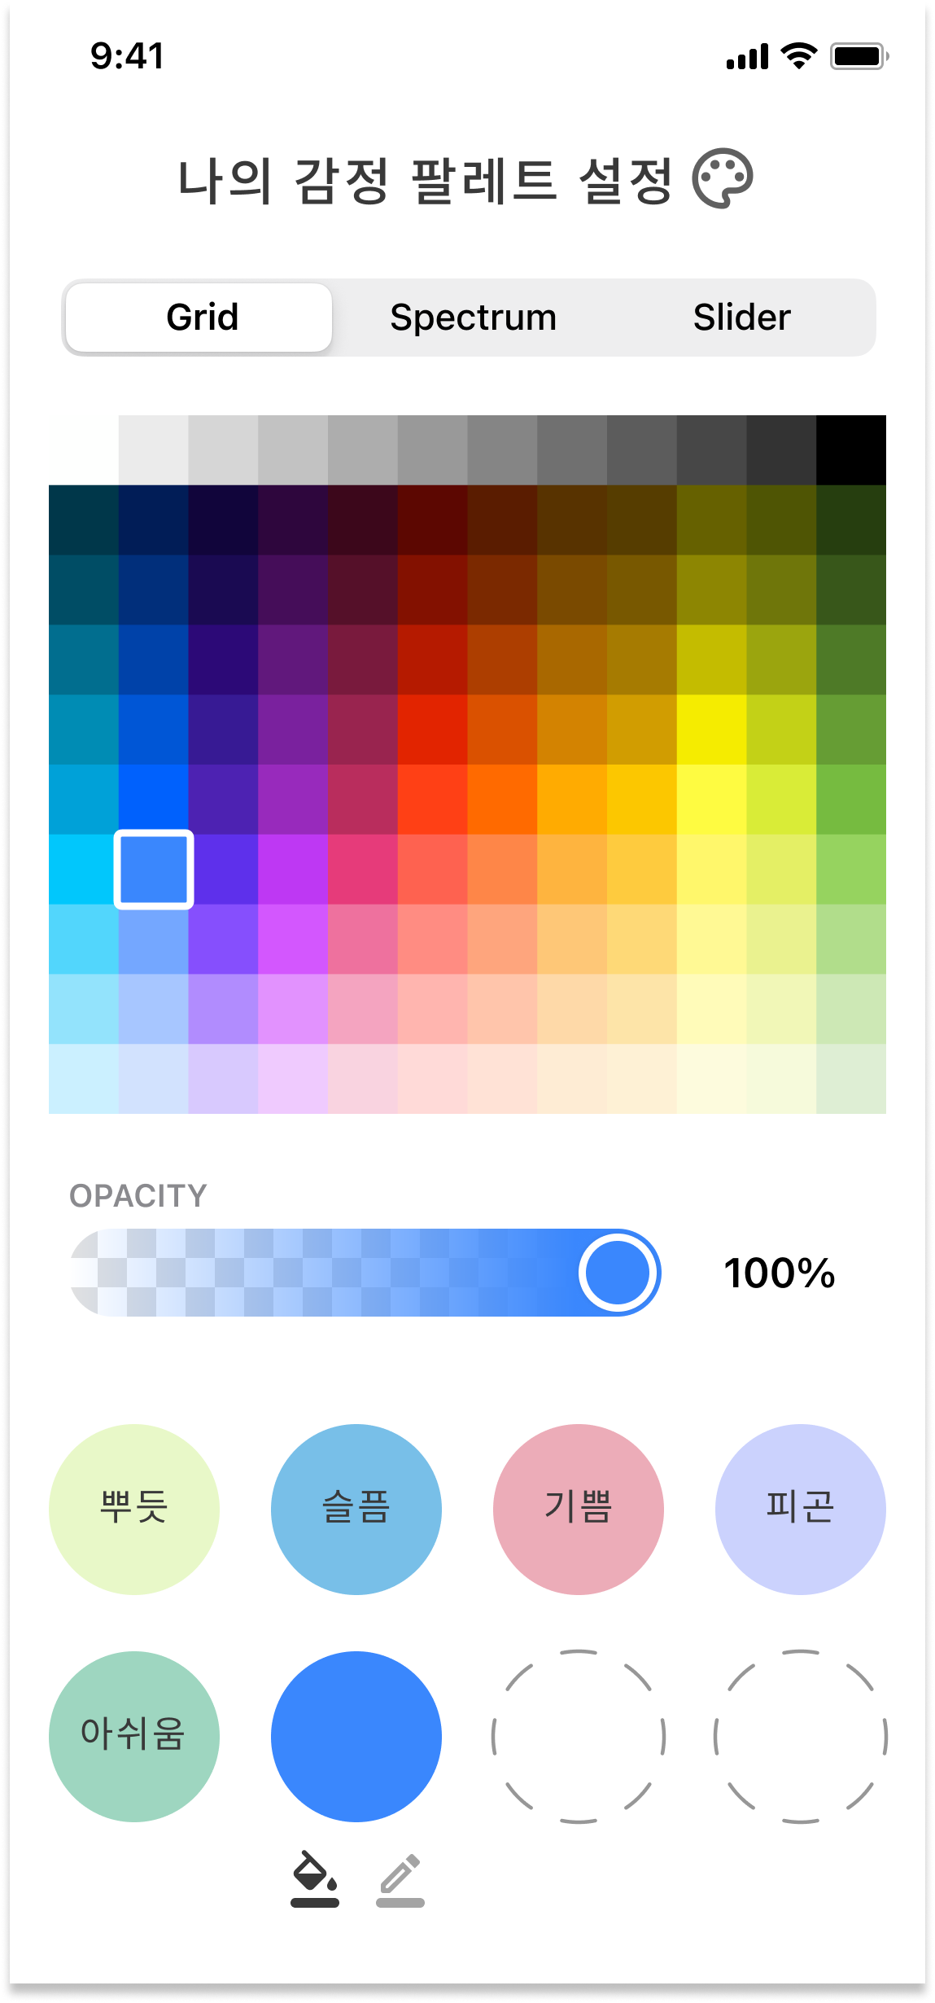
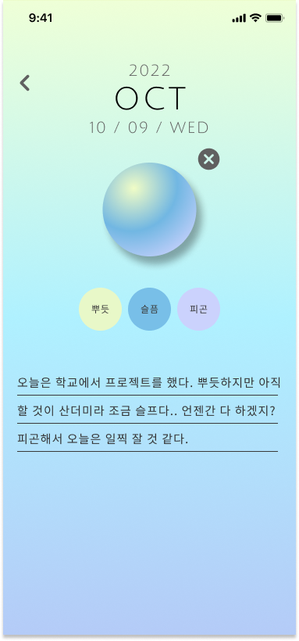
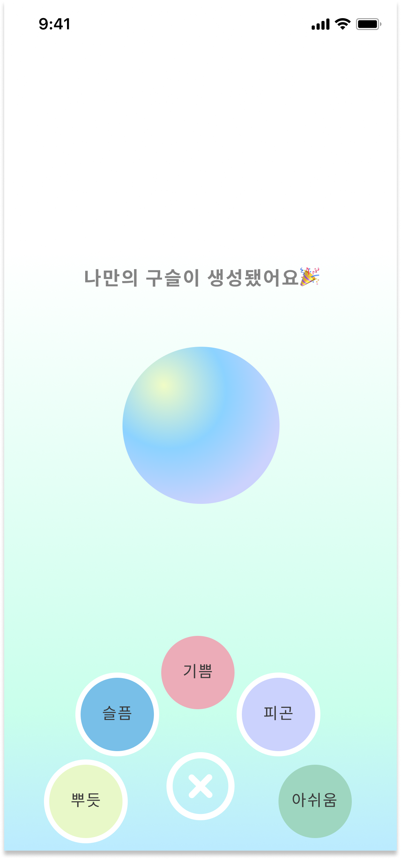
3. UI/UX
08
Notes:
기본적인 구슬 색 설정 및 다이어리 작성 페이지 설명

Slide 11
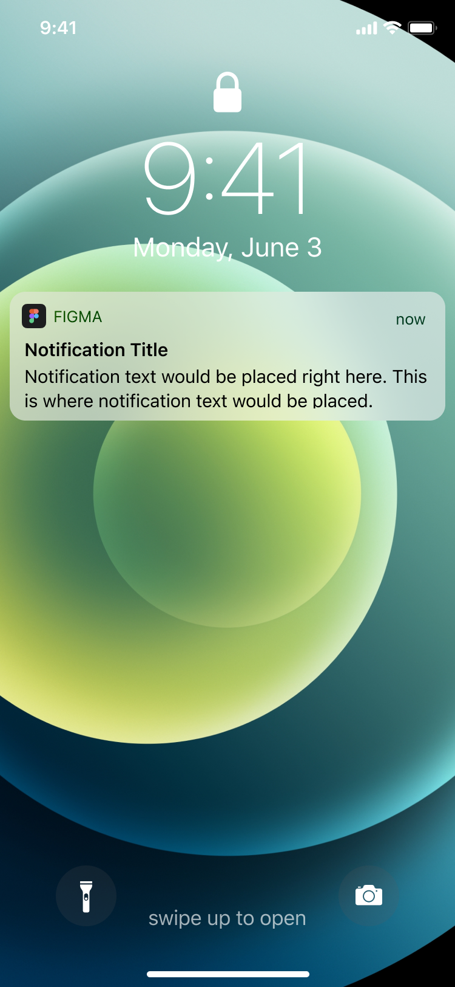
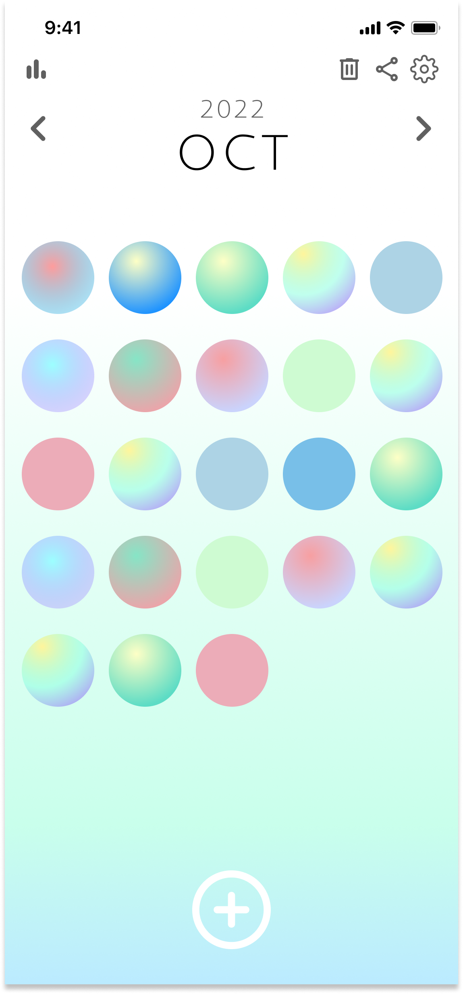
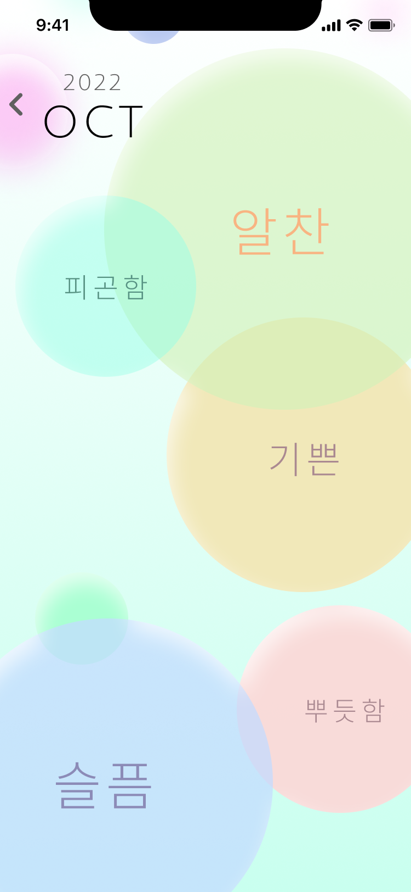
3. UI/UX
gradient – Figma
09
Notes:
월별 감정 통계를 확인하고 구슬을 모음으로써 일기를 매일 작성하는 유인이 될 수 있음을 설명

Slide 12
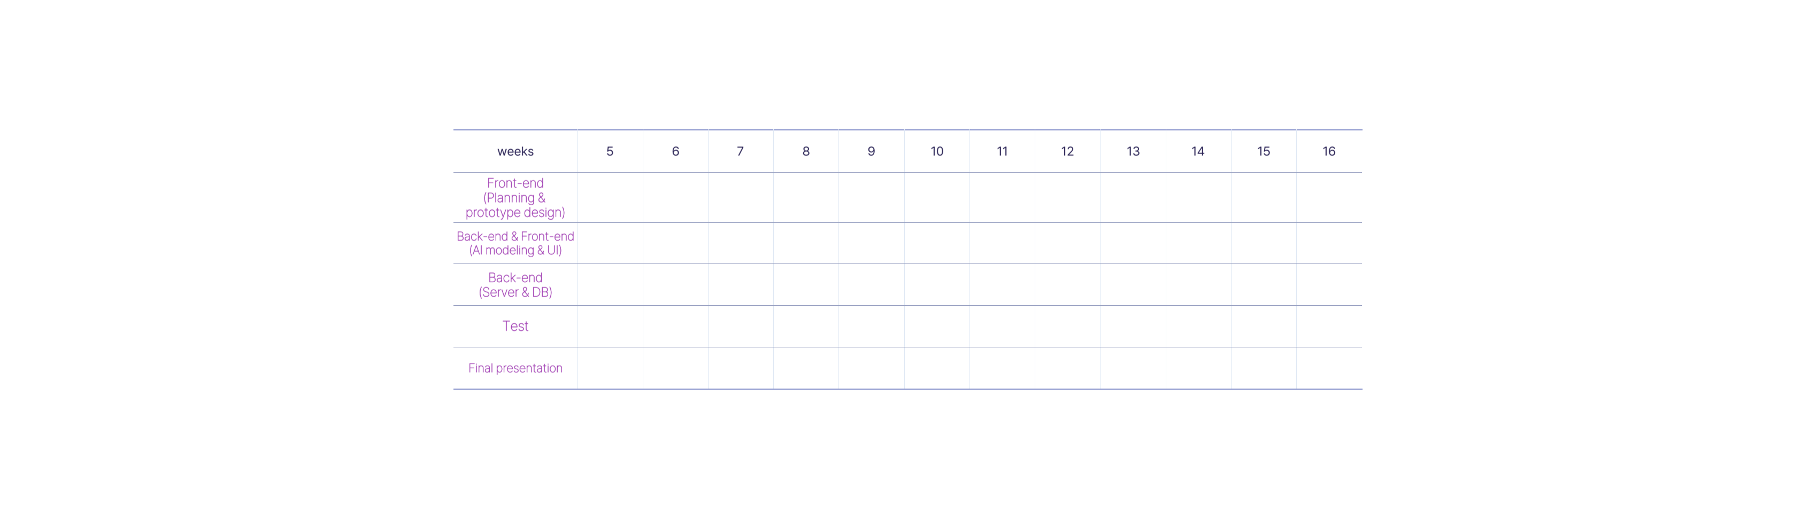










4. Plan
10
Notes:
다음번 발표까지 어느정도 구현할지 간략하게 이야기

Slide 13
Q&A

